Slide 1

Senior bureaucrats time managementans and efficiencies in their daily tasks
By- NILOY ROY

Slide 2
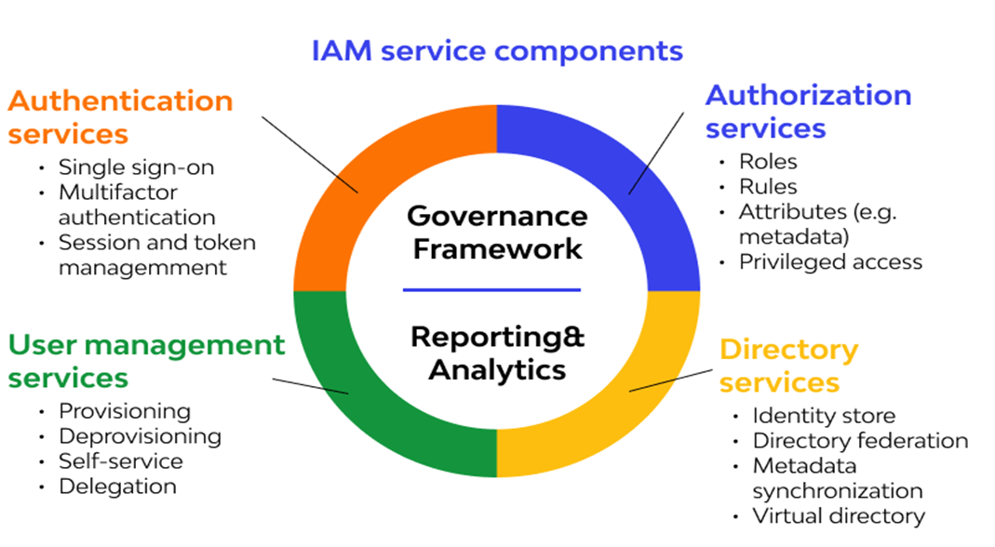
Components of Identity and Access Management (IAM) Users
With these new applications being created over the cloud, mobile and on-premise can hold sensitive and regulated information. It’s no longer acceptable and feasible to just create an Identity server and provide access based on the requests. In current times an organization should be able to track the flow of information and provide least privileged access as and when required, obviously with a large workforce and new applications being added every day it becomes quite difficult to do the same. So organizations specifically concentrate on managing identity and its access with the help of a few IAM tools. It’s quite obvious that it is very difficult for a single tool to manage everything but there are multiple IAM tools in the market that help the organizations with any of the few services given below.
Roles
Groups
Policies

Slide 3
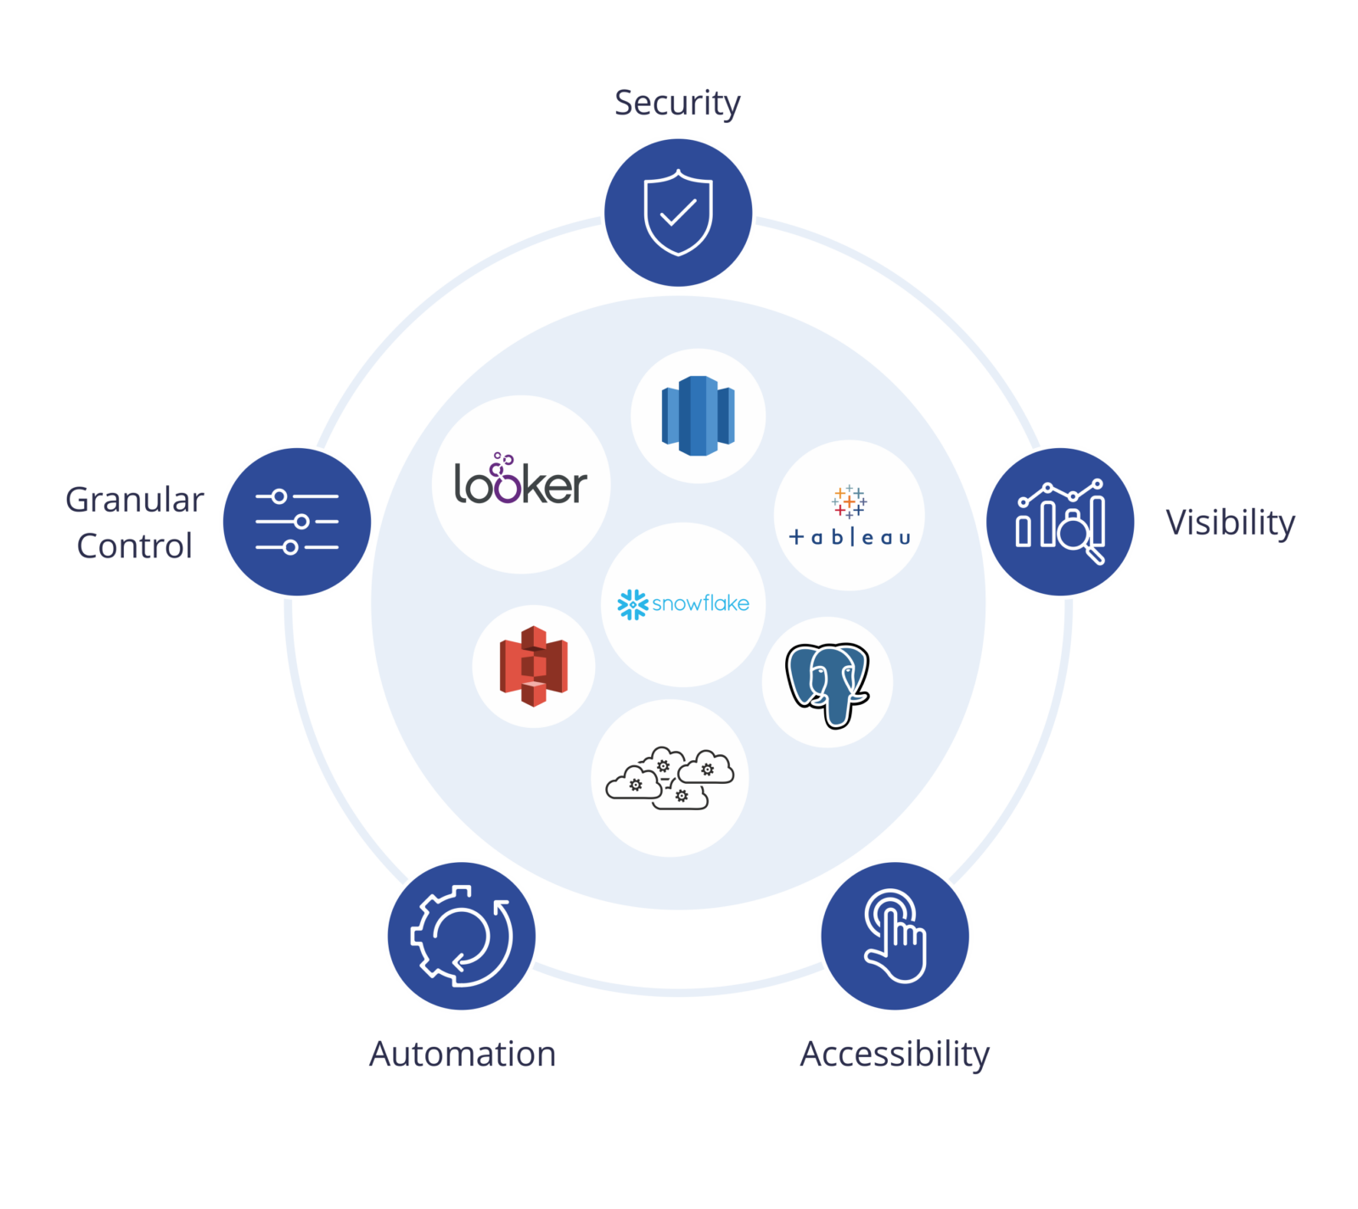
IAM Policies
IAM Policies can manage access for AWS by attaching them to the IAM Identities or resources IAM policies defines permissions of AWS identities and AWS resources when a user or any resource makes a request to AWS will validate these policies and confirms whether the request to be allowed or to be denied. AWS policies are stored in the form of Jason format the number of policies to be attached to particular IAM identities depends upon no.of permissions required for one IAM identity. IAM identity can have multiple policies attached to them.

Slide 4
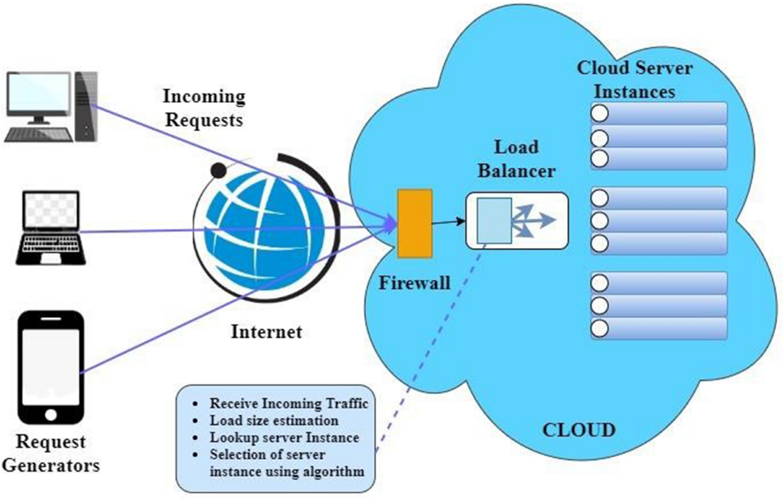
There are multiple techniques and algorithms used to minimize the energy consumption in cloud.
Techniques include:
Dynamic Voltage and Frequency Scaling (DVFS)
Virtual Machine (VM)
Migration and VM Consolidation
Algorithms are:
Maximum Bin Packing
Power Expand Min-Max and Minimization
Migrations
Highest Potential growth

Slide 5
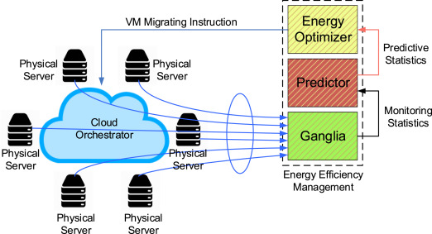
Green cloud computing is using Internet computing services from a service provider that has taken measures to reduce their environmental effect and also green cloud computing is cloud computing with less environmental impact.
Some measures taken by the Internet service providers to make their services more green are:
Use renewable energy sources.
Make the data center more energy efficient, for example by maximizing power usage efficiency (PUE).
Reuse waste heat from computer servers (e.g. to heat nearby buildings).
Make sure that all hardware is properly recycled at the end of its life.
Use hardware that has a long lifespan and contains little to no toxic materials.

Slide 6
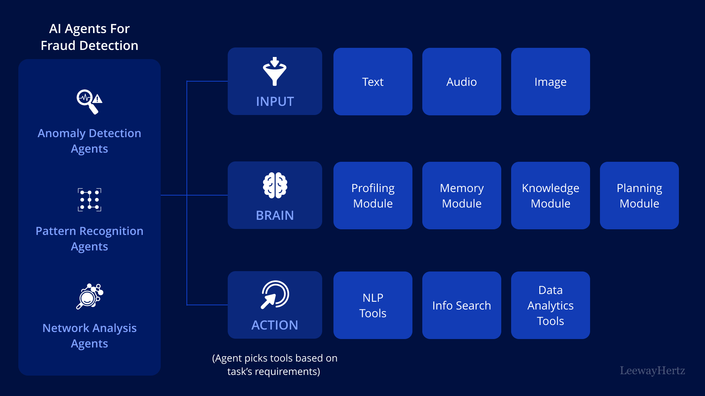
What is AI fraud detection
AI fraud detection is a technology-based approach that employs machine learning to identify fraudulent activities within large datasets. It involves training algorithms to recognize patterns and anomalies that signal possible fraud. By continuously learning from new data, these machine learning models become increasingly adept over time, improving their predictive accuracy and enabling them to adapt to evolving fraudulent tactics. This proactive defense mechanism equips businesses with a powerful tool for maintaining transaction integrity and security.

Slide 7
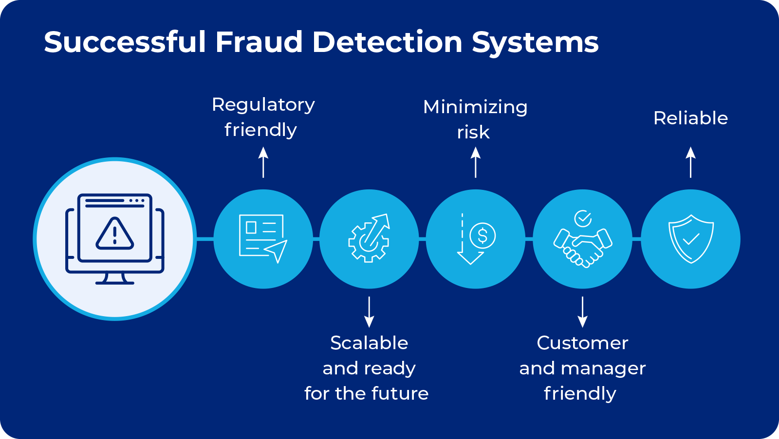
E-Commerce
For e-commerce platforms, AI fraud detection evaluates risk by considering factors like transaction size, frequency, and customer purchase history. It mitigates the risk of card-not-present fraud by cross-referencing shipping and billing information, identifying discrepancies that could indicate identity theft. The same AI systems are on the lookout for patterns of return and refund fraud, which are costly issues for retailers. These systems ensure a secure shopping experience, critical for customer retention, while also protecting the business’s bottom line.
Online gaming and virtual economies
Online gaming platforms and virtual economies are increasingly using AI to monitor for fraudulent transactions, such as the use of stolen credit cards to purchase in-game currency or the manipulation of game assets. AI algorithms can track transaction velocity, the geographic origin of transactions, and the transfer of in-game assets to identify
patterns that deviate from the norm, which may indicate money laundering or account takeovers. This not only
protects the game’s revenue but also enhances player trust, as it ensures a level playing field and the legitimate use of in-game economies.

Slide 8
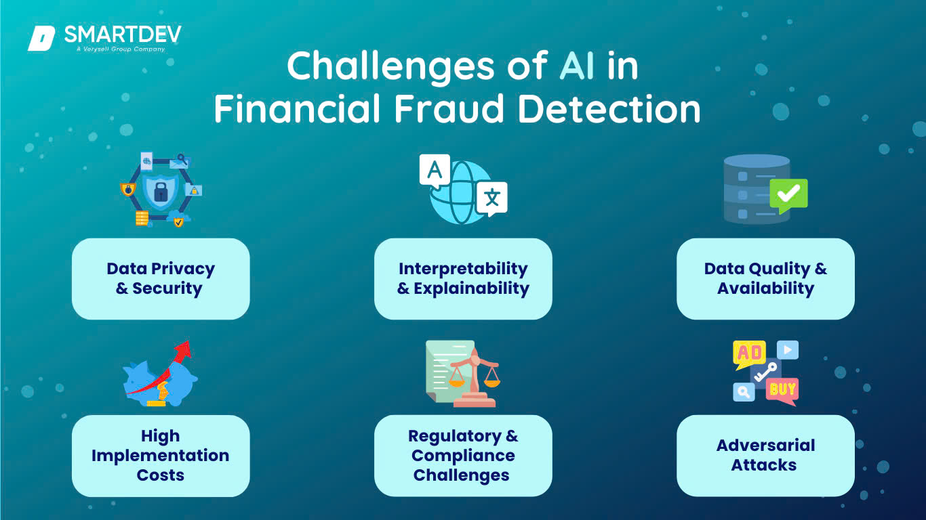
Regulatory compliance and ethical considerations
Businesses need to ensure that their AI fraud detection systems comply with all relevant regulations, including data protection and privacy laws like General Data Protection Regulation (GDPR). The use of AI in decision-making processes also raises ethical considerations, such as the potential for bias in algorithms, which can lead to unfair treatment of certain customer segments. Companies must navigate these regulatory and ethical landscapes carefully to maintain compliance and uphold ethical standards.

Slide 9
THANK YOU
TOPIC –AI-volution:Future Proof HACKATHON PROJECTS
WEB – www.ktj.in
TEAM ID. – royniloy1235_NILOY ROY
MY EMAIL ID. – royniloy1235@gmail.com
PRESENTED BY - NILOY ROY
CONTACT NO. - 6296154016
EMAIL ID. – royniloy1235@gmail.com

